Slide 1
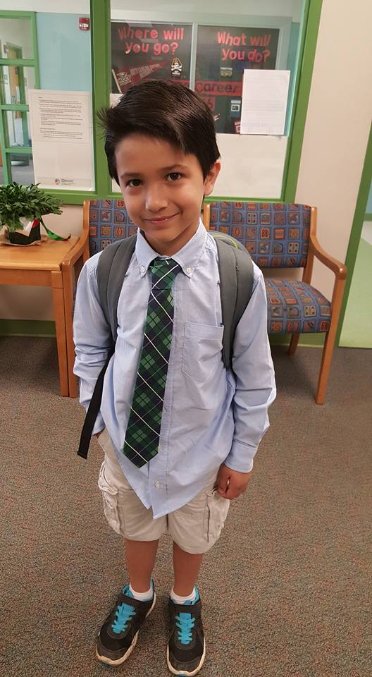
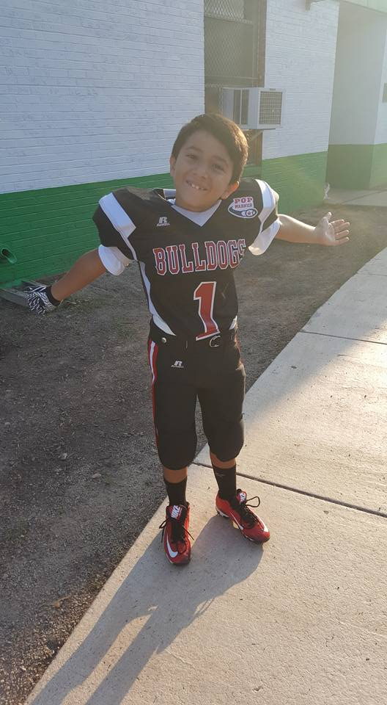
Jacob Edwards
My Family HERITAGE PROJECT
Ms. Zaccagnini’s class

Slide 2
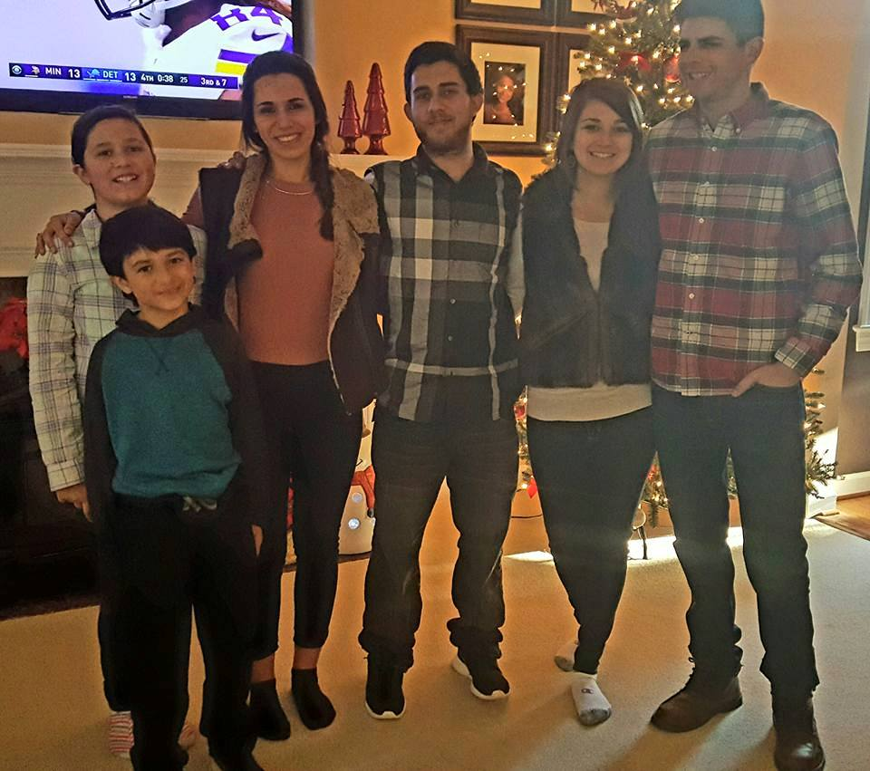
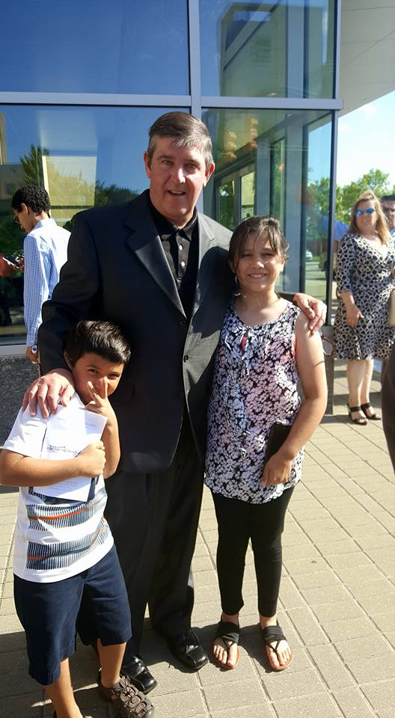
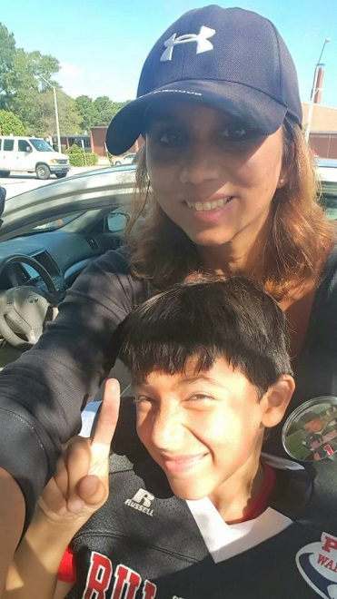
My Family
Me with my sisters, brother and my two cousins
Me with my dad and sister
Me with my Mom getting ready for football

Slide 3
My Heritage
My Mom’s side of the family is both American and South American (Peru)
My Dad’s side of the family is both American and British (England)

Slide 4
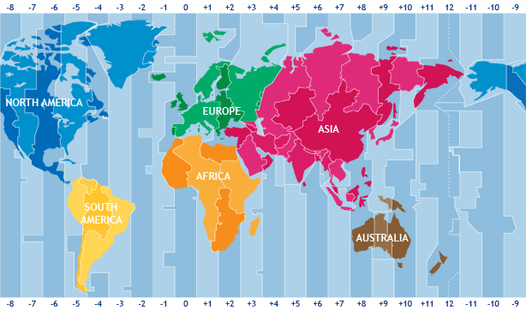
Where On Earth Is My Family From?
My family is from three different continents: North America, South America and Europe!

Slide 5
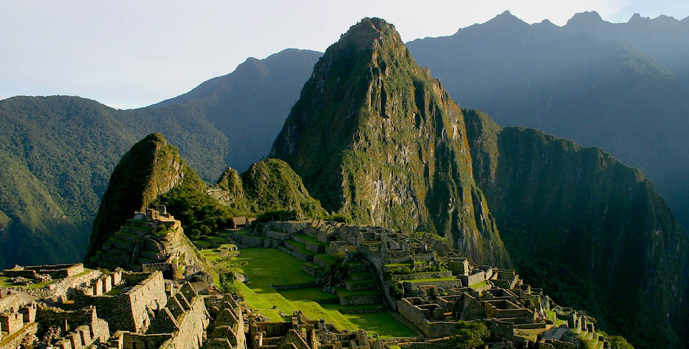
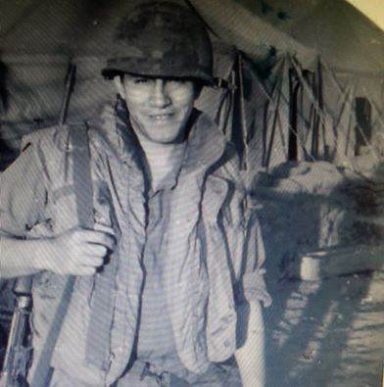
My Hispanic Heritage
My grandpa was born in Peru. He came to the US when he was a teenager and
went into the army to fight in the Vietnam war.
My mom was the first person in my grandpa’s family born in the US.

Slide 6
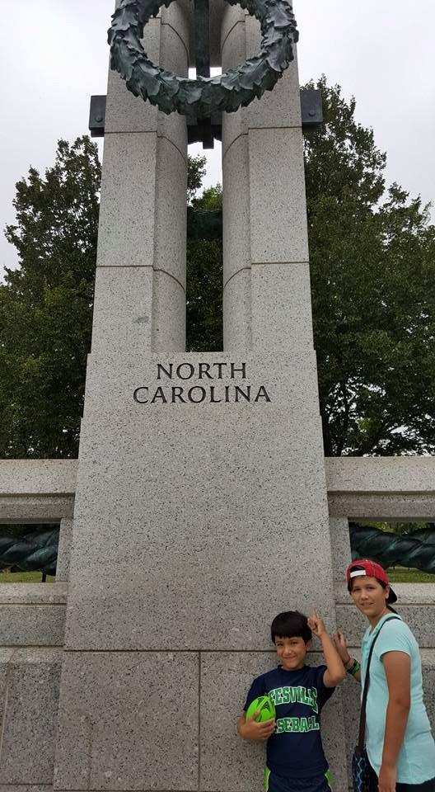
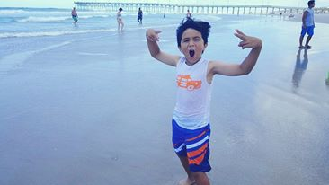
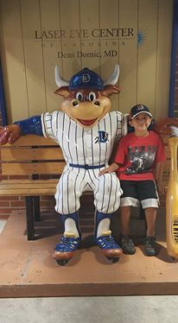
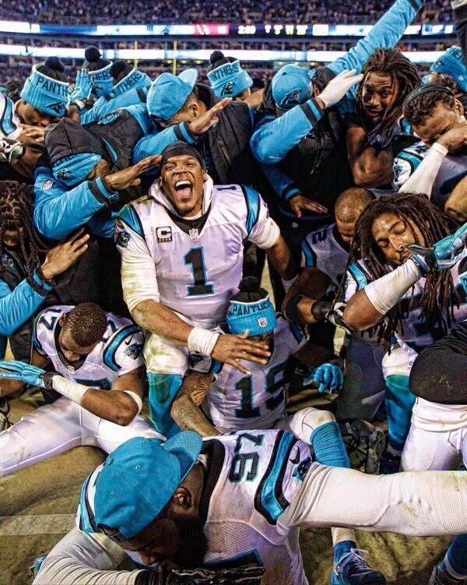
My American Heritage
I was born in Raleigh NC. My family has lived in Raleigh for 18 years.
I love living here and going to Durham Bulls games, going to the beach, and watching the Panthers play football.

Slide 7
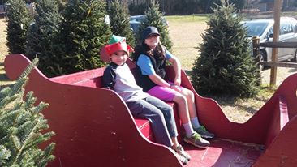
My Family Traditions
My favorite family traditions are going to pick out a real Christmas tree and getting new pajamas on Christmas Eve.

